Slide 1
App Modernisation
Codify’s ‘No-BS’ Look at Moving Your .NET Apps on Azure
Brisbane Azure User Group – 13 April 2022

Slide 2
Agenda
Why PaaS?
What is app modernisation?
Case study in fixing cloud anti-patterns
A new security paradigm
Anatomy of a modern app – on-premises patterns and their cloud equivalent
Home truths / saving money
Ask questions any time and we’ll answer them as we go!
.NET App Modernisation
Notes:
David
Talk through agenda above.
Remind people there will be a deck and handout for download – link in during the presentation
Remind people to ask questions as we go.

Slide 3
Introduction
David Connors | Codify
Dan van Eck | Codify
david@codify.com
0417 189 363
dan@codify.com
0413 993 708
Brisbane Azure User Group – 13 April 2022
.NET App Modernisation
Notes:
David / Dan
David intro, use his bio
Dan intro, use his bio
Hand over to David

Slide 4
PLAN
MIGRATE
RUN
CloudLift - Codify’s solution for creating an evidence-based plan for moving to Azure
Professional Services to digitally transform your organisation and get you to the cloud
Guidance, governance and Microsoft-backed support to continually optimise your cloud infrastructure
.NET App Modernisation
Notes:
David
We’re a Microsoft Gold Partner and Tier 1 / Direct CSP specialising in Cloud Platform
We are also recognised with an advanced specialisation in moving Windows and SQL Server workloads to Azure.
We’ve moved countless customers to Azure and manage them on an ongoing basis.
NO-BS – We’ll tell you what works and what does not. We’re in it for the long haul with our customers.
Plan
Our assessment offering helping customers build evidence based business cases
Migrate
Executing migrations for customers
Full Datacentre migrations
Specialist workloads such as TRIM and SAP
Bespoke apps and modernisation
Run
Our CSP offering
Governance as a Service

Slide 5
What does modernisation mean?
Moving as far up the value chain as possible
Synonymous with web apps
Desktop Applications
VB, C++, MS Access
Legacy Web Applications
Significant depdendency on COM+/nTier, ActiveX, High trust requirements (exes etc)
Web Applications
.NET, PHP, Node, Ruby, Python, Java
Action
Complete Rewrite or Deploy to Azure Virtual Desktop
Action
Partial rewrite and move to App Service
Action
Tweak and move to App Service
.NET App Modernisation
Notes:
David
What do we mean by modernisation?
Ownership: Lowering TCO as much as we can
Ideally, apps are deleted and replaced with SaaS or no code / low code
Implementation / Architecture: Using modern patterns:
Web based wherever possible
Yes there are places where binary apps are required for scenarios like industrial control but these are increasingly rare
Light weight approach to integration
REST/JSON > SOAP > COM+/EJB legacy
Modern authentication
Consider there options from worst to best.
Desktop applications:
No migration path for modernisation
Need rearchitecting and rewriting to modern web or offload to WVD
Legacy apps:
Anything before circa 2012 probably
Heavy use of legacy technology from old nTier world
Might need a lot of repluming
Web applications:
Anything new built sanely
Often can be redeployed without work
Sometimes needs specific tweaks

Slide 6
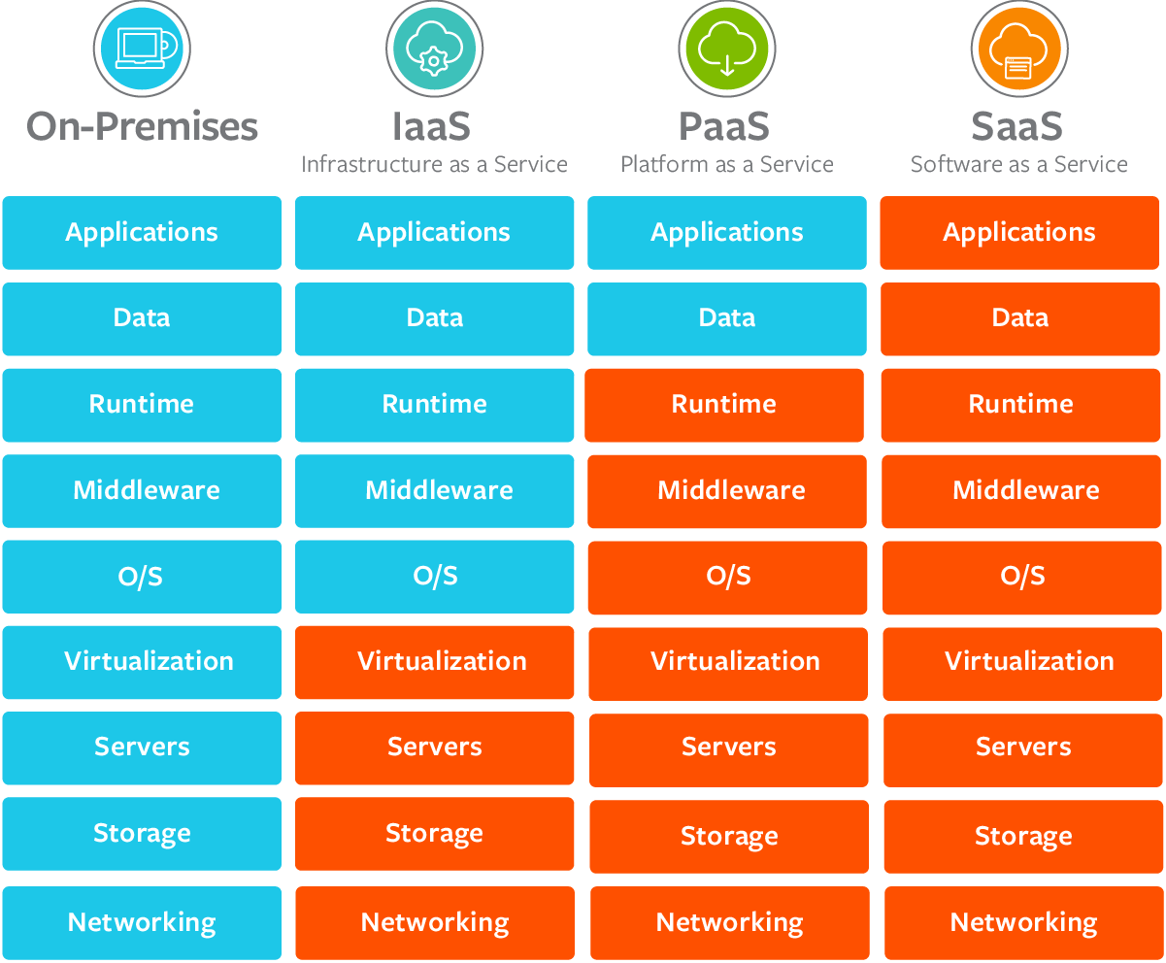
Why PaaS?
.NET App Modernisation
Notes:
David
There are broadly four deployment models today – this diagram should be familiar
On premises:
You worry about infra, disks popping, etc
IaaS
Hardware is managed
Storage is highly available by default
PaaS
You only think about your applications integrity
Increased security posture as everything is patched for you
SaaS is the gold standard for efficiency and true cloud consumption model
Not always possible
Rarely in the Enterprise due to custom requirements

Slide 7
Case Study – Fixing Cloud Anti-Patterns
Genomics app built for on-premises
External developer resistance to Cloud → “It will never work”
Our approach:
Source-level review of the application
Identify cloud “anti-patterns”
Create resolution plan for each item
Implement and deploy through DevOps
.NET App Modernisation
Notes:
David
Our customer commissioned the development of an app for a genomics problem
The developer chosen was very cloud resistant
We were engaged to help get the application to Azure
Read our approach section from above

Slide 8
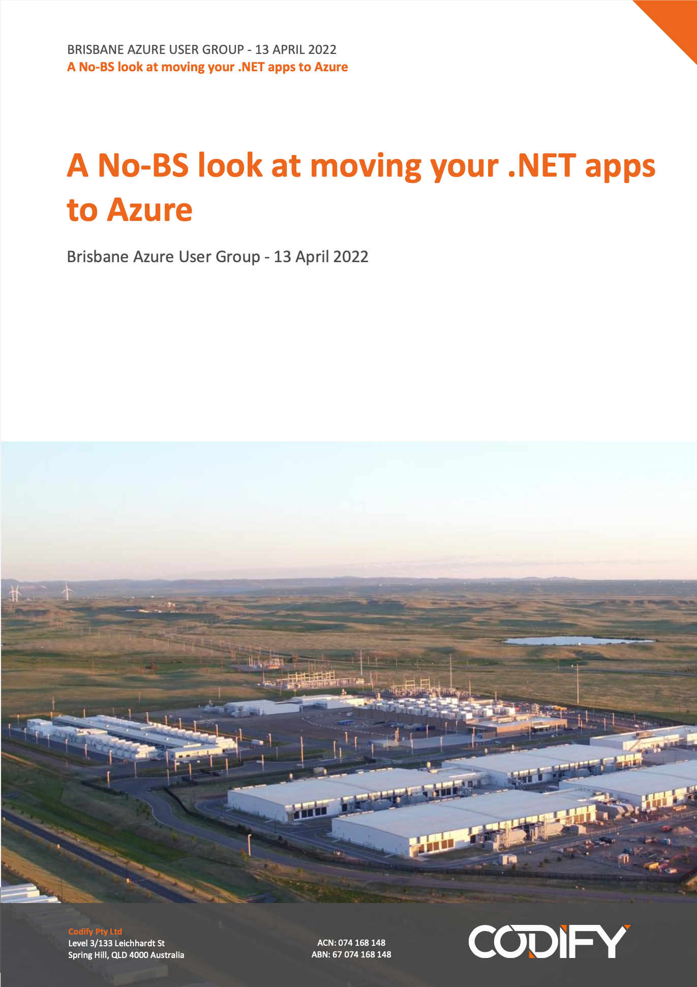
Case Study – Fixing Cloud Anti-Patterns
We have a well-worn checklist of items to assess application Cloud Readiness
This is a part of our standard Statements of Work
We’ve taken the best bits out and turned it into a whitepaper
You can download this at the end of the presentation
Download: https://cdfy.cc/baug-app-mod
.NET App Modernisation
Notes:
David
Present the above
Dan
Paste link in chat:
https://cdfy.cc/baug-app-mod

Slide 9
Case Study – Fixing Cloud Anti-Patterns
Anti-pattern | Resolution
Authentication The application used an Angular form to capture username and password and then authenticate against Active Directory. Numerous problems with this: Poor security (app handles secrets) Impossible to federate identities Bound to on-prem infrastructure | Replaced with Azure AD EasyAuth Turn-key solution enabled on App Service with no code. Trusted claim is presented to your app based on Azure AD All authentication and secret handling code removed from the application Highly resilient global Microsoft-managed infrastructure Federation out of the box using Azure AD B2B
.NET App Modernisation
Notes:
David
Forms based custom auth is a terrible idea
App handles secrets
No federation opportunity
What do we mean by federation? Benefits
Replaced EasyAuth
Single option to turn on in Azure AD
Secret handling is removed from your code
Benefits of a PaaS/SaaS identity solution
Nothing to manage
Highly resilient
Federation out of the box

Slide 10
Case Study – Fixing Cloud Anti-Patterns
Anti-pattern | Resolution
SQL Filestream and general file handling All binary data files (genomics data, images, PDF reports) stored in SQL filestream. Not supported by Azure SQL Database SQL-based storage is priced at a premium | Replaced with Azure Storage File handling code was removed from the application and replaced with native Azure storage. Scales independently of data tier Extremely low cost
Logging Serilog implementation with issues: Logs to disk which is ephemeral in Azure No analytics, alerting | Replaced with App Insights Azure App Insights was used to replace the existing stack with a PaaS offering. Benefits included: Solving dependency on App Service storage Rich dashboard provides insights into application performance, errors, etc.
.NET App Modernisation
Notes:
Dan
SQL Filestream
SQL is still the best engine for OLTP operations
Files under filestream go to disk but are fed via the SQL Server engine
Not supported by Azure SQL and even if it were, storing assets via SQL would likely be costly
You would also miss out on the Azure storage features (lifecycle management, versioning, etc)
Azure Storage
The binaries needed to exist transactionally with the SQL data but this is not possible in a heterogenous storage model
We opted to write the binaries to storage and upon success commit the meta data record to SQL Server
No chance of orphaned meta data
Benefits of taking this out of SQL Server
Made a move to the cloud possible
Simplifies back up and restore procedures significantly
Question mark hanging over the head of the filestream feature anyway
Access the full benefits of Azure storage
Logging
Existing solution was really the minimum viable logging
Requires high trust to write to the Application Log
The vendor did not think about operational requirements
How do I look at these logs without going into the VM?
How do I parse the logs and query them for insights?
How do I create alerts for operational issues?
How do I retain and rotate them over time?
Azure App Insights
Replaced the logging infrastructure with Azure App Insights
Externalises logs from the application
Lets you set retention policies
Can bubble data up to Azure monitor
Possible to set up log queries
The queries can be leveraged to set up alerts
Allows deep dive into exceptions when a runtime error occurs
Eg see full stack trace, underlying SQL commands
Gave us performance characteristics out of the box so we can see which endpoints were hot and where the devs need to focus optimisation efforts

Slide 11
Case Study – Fixing Cloud Anti-Patterns
Anti-pattern | Resolution
Label Printing Assumed direct connectivity between the app tier and label printers at various remote sites. | VNet Integration Azure App Service VNet Integration was used to facilitate connectivity from Azure App Service public scale units to the customer’s RFC1918 address space.
DevOps Existing DevOps infrastructure was a mixture of solutions. Build processes were poorly orchestrated and environment alignment was poor. Customer had no visibility over check-ins, releases, or any other part of the software development lifecycle. | Replaced with Azure DevOps The build and release process was replaced with Azure DevOps. Redundant and complex build processes were replaced with a streamlined architecture acting as a single point of truth.
.NET App Modernisation
Notes:
David
The genomics solution needed print barcodes to track samples as they were analysed in various lab environments
The printers were addressable via TCP socket on the customer’s WAN
Moving to public scale unit App Service means this connectivity was not initially possible
VNet integration was released around this time
DON’T TALK ABOUT VNET and PRIVATE LINK TOO MUCH – IT IS ON THE NEXT SLIDE
This enabled integration of the App Service with the customer’s corporate network
This has been running for 1.5 years or so now and proven completely reliable
Dan
On Premises DevOps
Current solution was very substandard
Customer did not control the IP or the processes
Makes breaking up with a supplier hard if push comes to shove
No visibility over what is being written
No visibility over what has been released to what environments
Complete reliance on the supplier to publish changes between environment stages
Azure DevOps
Re-engineered the DevOps SDLC to be based around Azure DevOps
Puts the customer in control of their own source code and destiny
Supplier pushes code to the customer’s tenancy leveraging federated identities
Automated deployment to CI
Customer’s testers could deploy builds to the test environment at will and in a controlled and audited fashion
Full visibility and tracability at which version each environment stage is at

Slide 12
A new security paradigm
Many cloud services are public by default
New Azure services let you connect these to your corporate network both inbound and outbound
Azure VNet Integration allows public services like App Services to connect to on-premises resources
Azure PrivateLink takes public services like App Service and Azure SQL Database and makes these available on your private address space
You have the architectural flexibility to deploy services publicly or privately
.NET App Modernisation
Notes:
David
A lot has changed recently in Azure
Azure VNet integration has been around for some time
Azure PrivateLink is a new service
Being progressively rolled out across Azure services with extensive coverage
Everything you need for app modernisation is there today
App Service, Service Bus, Azure SQL, Azure Synapse, Azure Monitor / App Insights, Key Vault.
VNet integration allows your apps to reach into your private address space
Optionally on-premises if you have ExpressRoute or Site to Site VPN in place
PrivateLink allows you to take your PaaS service off the public edge of Azure and expose it on your private address space
If you have security requirements that mean network must be the perimeter (finserv?) then this can be helpful
Architectural choices are flexible and you can chop and change as you see fit

Slide 13
Zero Trust & Identity as the perimeter
Focus on identity being the perimeter of your network
Everyone does this for e-mail & banking today
Why should your app be any different?
Moving to Azure AD for auth supports this:
Enforcement of corporate multi-factor authentication standards
Integration with existing SIEM/SOAR workflows
Integration with external partners/subcontractors is seamless
.NET App Modernisation
Notes:
David
We recommend you consider making identity the perimeter wherever possible
Get off IIS+Windows Auth and on to Azure AD
Enables so much
Federation
We keep going on about it but it really will change how to interact with partners
All of our apps – portal.codify.com, CloudLift, etc are powered by Azure AD with federation
When we onboard our customers we don’t send them new secrets they use their own corporate identity from their Azure AD
Gets your app onboard with MFA, SIEM/SOAR
Security guys might not love it but really – everyone transacts online with an identity perimeter for much more sensitive things – online banking, corporate e-mail, etc.

Slide 14
Anatomy of Modern Apps
On Premises | Cloud
Team Foundation Server, Visual SourceSafe, TeamCity, Subversion, etc On-premises solutions come in all shapes and sizes however organisations rarely implement a single solution encompassing work item management, build, and release. | Azure DevOps Microsoft’s integrated DevOps platform. Free cost of entry Available globally, authenticated with Azure AD Single integrated platform covering: Source Control (Git or legacy TFVC) Work item management Build Testing Deployment and Release management Seamless integration to Azure for deployment
.NET App Modernisation
Notes:
Dan
On-premises
Every org is different and uses a mishmash of tooling
Installed on servers
Discovery (how do I get to it) is usually a problem
What is Azure DevOps
Addresses the entire SDLC
Boards = Work Item Management
Backlog management
Sprints
Release planning with Roadmaps
Delivery Plans
Portfolios
Traceability
Repos
Source code repositories
TFVC and Git both supported
We recommend move to Git ASAP
TFVC is terrible
Locked files kills productivity
One of our customers spent 6 hours every Thursday merging – this is instant in Git
Pipelines
Builds your app!
Hosted agent for standard requirements
Custom agent if things are complex. We used a custom agent in the genomics solution as the developers chose katalon as a test engine
Manages environments
Manages releases
Can hook straight into Azure via a service principal to deploy
Configuration per environment can be stored as a part of the pipeline and transformed into the config at deploy time. Secrets don’t sit around in repos. Can also hook into KeyVault for secret management
Full visibility of what versions are in what environment.
Simple rollback to previous versions
Test Plans
Microsoft’s solution for manual and automated testing
Fairly expensive for what it does and probably only suitable for high impact enterprise apps with professional testers engaged
Artifacts
Place to store your own nuget packages
Talk about the security problems of nugetting from the Internet
This allows you to make a whitelisted / curated selection of these packages for use.
Azure DevOps seamlessly integrates with Azure

Slide 15
Anatomy of Modern Apps
On Premises | Cloud
Windows + SQL Server Very expensive licensing / high cost of entry. Bundled with complex features not required for typical web applications. High Availability and Scaling is expensive and complicated. Backup and Disaster recovery requires specialist skillset. | Azure SQL Database Microsoft’s platform as a service SQL Server offering. Low cost of entry High fidelity support of SQL Server functionality – most day to day operations are supported Wide array of service tiers at corresponding cost points Flexibility to jump between service tiers. Cost optimisation possible through elasticity Scaling, backups, disaster recovery are all built in single click operations.
.NET App Modernisation
Notes:
David
SQL Server is very difficult to manage properly
Backup and disaster recovery is difficult and often not managed properly in on premises environments
We’ve seen countless examples of outages caused by something as simple as log truncation failure
High availability and horizontal scaling are both complex tasks that require specialist skills
Azure SQL Database is the ‘PaaSified’ version of SQL Server
Very low cost of entry
It implements a relatively good subset of T-SQL
Most of the day to day operations are supported
Areas where functionality have been removed:
Linked Servers support
xp_* stored procedures
No CLR support
These artefacts need to be remediated before moving to Azure SQL Database.
Near full fidelity can be achieved with SQL Managed Instance if that is important.
Hyperscale is also an option if you have extremely large datasets.

Slide 16
Anatomy of Modern Apps
On Premises | Cloud
Windows + Internet Information Services The default option for delivering Microsoft ecosystem web apps on premises is Windows Server running Internet Information Services. Required management and patching of servers Scale out require load balancers, etc Publishing to the Internet involves proxies, firewalls, etc Windows Server is a huge service area for publishing a web application. Not software-defined. Consistency is a challenge. | Azure App Service Microsoft’s platform as a service for delivering web applications in the cloud. Free cost of entry Serves node, .NET, Python, PHP, Java or containerised apps out of the box. Software-defined configuration. Horizonal and vertical scaling. No infrastructure to manage.
.NET App Modernisation
Notes:
Dan
IIS
Traditionally websites were set up in IIS by hand
Settings on each IIS sites were usually configured during initial setup (bindings etc)
When something went wrong / a new server needed to be set up, it was error prone to set up a new instance with correct settings
Required work to scale out rather than up
App Service
Hosted on app service plan, which is the unit of compute
May apps can be hosted on the same app service plan for cost savings / efficiency
Comes in both windows and linux flavours
With app service, settings can be set at a platform level and Azure abstracts the implementation away from you
Scalability is taken care of for you – you can scale horizontally or vertically very easily
Settings to maintain session affinity when apps can’t round robin for scale out
You can go from nothing to having an app up and running, available on the internet, within a few minutes

Slide 17
Anatomy of Modern Apps
On Premises | Cloud
Active Directory Authentication is performed by Windows or Basic + TLS in Internet Information Services Tightly bound to on-premises Does not support modern authentication best practice such as MFA | Azure Active Directory Azure’s compliment to on-premises Active Directory. Same authentication engine used by Office 365, etc. Trivial to enable B2B scenarios Full support for MFA, threat protection, etc Leverages by other Azure services and trivial to add to an App Service B2C variants available for high usage membership type scenarios
.NET App Modernisation
Notes:
David
On Premises
In an on-premises world web apps are normally authenticated against Active Directory using Windows auth in IIS
This is functional and gets the job done however there are numerous limitations when compared to a modern approach
Tight binding to on-premises AD structure makes federation impossible
Completely outside of modern auth technology such as MFA, passwordless sign in
Azure Active Directory
Operates either as a replica of on premises AD or stand alone
It is the same authentication engine used by the rest of the Microsoft cloud
Full support for modern authentication, threat protection and so on
AAD is suitable for authenticating
Your domain users
External business partners by B2B integration
Large scale apps delivered to consumers are not suitable for your standard AAD instance
For these instances use B2C
Implements a separate directory
Supports millions of objects
It is a different and separate path to AAD and does not integrate – but supports many of the same features

Slide 18
Anatomy of Modern Apps
On Premises | Cloud
C:\etc or \\yourfileserver\etc Reliance on fixed disk volumes that can fill up Does not scale effectively Uses normal filesystem semantics | Azure Storage Microsoft’s platform as a service storage offering. Unlimited storage capacity Scales (for practical purposes) infinitely Modern REST/JSON calling convention supported by SDKs Storage is independent of compute so works well in scaling architectures Point-in-time restore, versioning, soft deletion, change tracking, immutability NFS support Gateway to advanced BI solutions like Synapse
.NET App Modernisation
Notes:
Dan
Traditionally, web apps would write to local or network mounted storage
The application would use standard File IO api’s available through windows
Maintenance and availability of this file storage was responsibility of the ops team. They would need to make sure:
Enough storage is available
Storage is backed up
Any advanced features such as soft deletes or versioning would have to be built into the application
In the cloud, this is replaced by Azure Storage
Azure storage consists of Blob Storage, File Shares, and Queues
In this case we’re looking at Blob Storage
You can interact with Azure Storage using REST API’s, and SDKs are available in most languages to make this easier
Azure Storage has many advanced features available out of the box, including:
Versioning
Point-in-time restore
Immutability / legal hold
Change Tracking
Soft delete
Dovetails nicely into other Azure Services, for example Azure Synapse, and gets you Synapse ready for analytics
Discuss use cases for telemetry logging. How we wish it existed when we wrote CloudLift.

Slide 19
Anatomy of Modern Apps
On Premises | Cloud
SSRS Default reporting solution for SQL Server Practically abandonware | PowerBI Modern PaaS / SaaS offering to facilitate reporting and dashboards Amenable to end-user self-service use cases Functions outside of your application so allows you to offload code
.NET App Modernisation
Notes:
David
SSRS is functionally abandonware
It was the go-to solution for tabular reporting however it has been left behind.
PowerBI is Microsoft’s modern approach to dashboard reporting
Has been more recently extended to support tabular data requirements
As a tool it is amenable to end-user self service use cases if the schema is structured in a way that makes sense to them

Slide 20
Anatomy of Modern Apps
On Premises | Cloud
SSIS / SSAS Default integration and analysis solutions for SQL Server Practically abandonware | Azure Synapse Combination of data warehousing and analytics delivered as PaaS/SaaS Leverages Azure Storage Gen 2 for cost effective storage SQL On-demand Advanced machine learning scenarios through Databricks Fully mature DevOps story unlike SSIS and SSAS
.NET App Modernisation
Notes:
David
SQL Server Integration Services and SQL Server Analysis Services are both legacy technologies
SSAS is extremely expensive to run in the cloud due to its thirst for memory
Microsoft has been through a few iterations of their Azure BI story
Synapse has ‘turned the corner’ in terms of maturity relative to previous offerings
Storage is backed on to standard Azure storage accounts
You can perform analysis operations using committed resources or use SQL on-demand
SQL on-demand is really exciting as it is a purely consumption model – pay per TB of data processed
Queries are run from heterogeneous files in Azure storage rather than out of an MDF and work is fanned out across massive consumption farms.
Discuss CloudLift telemetry use case and how this would have worked with SQL on-demand
Once you move past T-SQL analysis you’re in a position to do ML using Databricks off the same platform
Unlike the on-premises counterparts, there is a fully mature DevOps story underpinning these offerings.
Design in a GUI, save operations are committed to Git.

Slide 21
Anatomy of Modern Apps
On Premises | Cloud
Logging Rarely done properly on-premises Usually goes to text files or writes to the event log | Azure Monitor / AppInsights / App Service Logs Out of the box operationalised service Events can be logged and surfaced to a comprehensive management portal outside of the application Supports dashboard, advanced query capabilities Alerting via e-mail, SMS, voice can be configured Two levels of implementation complexity: Out of the box, requests, etc Advanced instrumentation possible with custom implementation
.NET App Modernisation
Notes:
Dan
On-premises applications usually writes to:
Local txt/log files, rolling a new file each day, or
Windows Event Log
In both these cases, operational management concerns are not taken into account:
Engineers need to remote into the VM to see the log file or view the event log
No data is bubbled up centrally for analytics purposes
Data keeps growing over time without a way to trim / manage growth
In Azure, logging is usually done using Application Insights / Azure Monitor
App Insights will give you a lot of monitoring out of the box by installing an agent into your app service, e.g.
Performance measurements (which URLs / api endpoints are taking the longest to respond, which endpoints are most frequently called etc)
SQL calls made by the application, and how long those calls took
With some code level instrumentation, you can get full stack traces of errors and see the dependency tree for diagnosis
View errors aggregated over time to see which errors are most persistent / need attention
See application performance before vs after a release
Set up alerts based on kusto queries
Get notified of unusual error activity

Slide 22
Anatomy of Modern Apps
On Premises | Cloud
Windows Services / Task Scheduler Batch processing jobs such as sending e-mail reminders are typically implemented as Scheduled Tasks No management reporting Scales to the host it is running on | Azure Functions Event-driven serverless compute platform. Multitude of trigger types for jobs web hooks, blob creation, time-based events Scales horizontally Provides management reporting Pay on-demand or hosted along side existing app services
.NET App Modernisation
Notes:
Dan
Most application workloads consist of at least one background / batch process
Usually these would be written as a windows service which continuously processes data
These are difficult to administer – engineers would have to remote into the server to see if its running, restart it etc
Required service accounts to be set up and managed for the service to run under, and inevitably the password would be known / written down by developers etc
No centralised / ops reporting
In Azure, this is replaced by Azure Functions
Out of the box includes many trigger types to start the function processing, including
Timer / cron schedule
Continuous
Blob
Service Bus Messages
Http endpoint
Functions have a much easier programming model and debug / launch model than services
No need for service installs, which typically proved a headache
Easily scaled out
Can be run on demand / dynamically, or hosted on an existing app service plan along side your web apps
Provides centralised management in the portal for operations, and can hook into app insights to send logging / telemetry to Azure Monitor
Managed Identity used for authentication to other Azure Resources

Slide 23
Anatomy of Modern Apps
On Premises | Cloud
Message Queuing MSMQ is the default on-premises solution Legacy solution - abandoned | Azure Service Bus Cloud based message broker with queuing. Modern queuing solution that implements queues and pub/sub concepts well Different scaling tiers at various price points Turn key solution that requires no set up
.NET App Modernisation
Notes:
Dan
Message queueing is used by advanced applications to scale out or to process work out of band
On-prem you would usually implement this using MSMQ from Microsoft or RabbitMQ
Both of these require installation and maintenance on a usually dedicated server. Scaling out the solution requires building more infrastructure
In Azure, we can use Azure Service Bus for messaging and queuing
Allows standard queues to be used, as well as more advanced publish and subscribe models
Available in different service tiers, and you can scale between them without penalty
No need to manage installations / servers / patching / scaling
Can get it up and running in a few minutes, very easily provision multiple instances for each developer / app

Slide 24
Anatomy of Modern Apps
On Premises | Cloud
Secret Management No default on-premises solution PKI assets on filesystem or secrets in web.config are not uncommon | Azure Key Vault Cloud based vault for managing sensitive information. Stores secrets, private/public key pairs and credential pairs Access can be secured using RBAC and Azure AD Secrets are versioned Apps can only retrieve their credentials using managed identities at runtime.
.NET App Modernisation
Notes:
David
Let’s not kid ourselves … everyone’s attempts at secret management on prem are patchy at best
There is no default on-premises solution for secret and certificate management
In our experience, finding pvk or pfx on filesystem and/or credentials in a web.config are not uncommon
Migrating to the cloud is a chance to break with the old bad habits
Azure Key Vault
Managed store for key pairs, credential pairs and other secrets such as API keys
Fully securable with Azure Roles Based Access Control
This ensures only designated operators can manage resources
Importantly the same security model is used by applications at runtime
An application uses its service principal to log on to the key vault and retrieve sensitive information at runtime
This removes all of this information out of source and build and away from the development team
Key Vault can be used with the App Service Certificate service to automatically renew SSL certificates.
Once renewed these are pushed to app services automatically.

Slide 25
From the Trenches
A couple of home truths

Slide 26
Stories from the trenches
App Service Environment
Billed as “highly scalable” – not exactly
Stamp fees → Expensive (recently changed policy)
Slow to scale
Management is a headache
Look to App Service with VNet Integration and Private Link instead
.NET App Modernisation
Notes:
David
Architecture
Why was ASE built
Deploys a whole stamp of infrastructure just for your app
Touted as highly scalable
Only good feature
The only real problem it solved was putting App Service on RFC1918 address space
Cost
ASE charges a stamp fee of ~2K a month. This has been removed in ASE v3 however bad luck if you’re on V1 or V2
The cost of compute is significantly higher per core and GB of RAM
Replacement project
We have been systematically working through our Managed Azure customers with ASE and replacing them with VNet integration and Private Link
We moved about 50 web apps off an ASE at one customer on to App Service without incident
This is saving that customer around $25K per annum
Notwithstanding the stamp fee, there are technical issues which Dan can highlight.
Dan
One of the primary benefits of App Services is easily and quickly scaling out. With an ASE, scaling out can take a very long time (hours) – even setting up the ASE initially can run for around 4 hours.
App services on the other hand do this within minutes
Because the ASE SCM endpoints (kudu) is not publicly accessible by default, it also means that the hosted devops agents cannot see it for deployment. This means that you need to provision and then register a customer deployment agent inside of your azure tenancy so that it can communicate with the ASE for deployment integration and then register the scm endpoints in your DNS server.
When inevitably developers need to access the files on the server for diagnostics, you typically go to the kudu interface or app service editor. The Kudu endpoints are not publicly available, meaning you will need to VPN into your network first in order to open it, and the App Service editor feature is not even visible on the ASE.
Generally it just feels like the features being released on app services lags behind on ASE – not really a focus

Slide 27
Stories from the trenches
Scaling Azure SQL Database
The scaling dimensions that matter aren’t on the product sheet
Not all DTUs are equal
S-series
Okay for most workloads
Okay for transactional
P-series
Not necessarily or always batter than S-series for transactional
Always better (a LOT) for sustained throughput
Has a read-only replica included
.NET App Modernisation
Notes:
David
Azure SQL Database is scaled by DTU or vCore models
DTU is just a number of times a given scale size can complete some arbitrary and undisclosed SQL statement
vCore is as the name suggested – virtual cores allocated to your DB
Microsoft is pretty cagey on the underlying filesystem IO and this does not factor into the DTU or vCore models
It’s probably a bit telling that DTU used to stand for Database Throughput Units but has been renamed to Database Transaction Units
Compare S6 instance with P1
S6 = 400 DTU
P1 = 125 DTU
S6 will likely outperform a P1 for a number of simple queries
Think shopping cart operations, etc
P1, despite lower DTU, will FLOG an S6 as the IO reads heat up
Anything that remotely looks like an aggregate over a large table will be many fold faster on a P1.
Lesson: Compare performance across a variety of options with your unique workload
Dan
Anything in the premium tier contains a built in read-only replica. You can target this endpoint by specifying it in the connection string
Example: Our automation platform
constantly reads statistics to send out alerts for cost management
preserve the primary node for OLTP work
Regularly review the index recommendations in the portal – it analyses your workload on an ongoing basis and recommends new indexes to improve performance
Azure SQL does not have the concept of backing up and restoring .bak files. Instead you use imports and exports (although it does have built in backups that can be restored).
Exporting a DB can take a long time and has a large performance impact (100% usage)
If this matters, clone the DB (which doesn’t impact performance) and then export the clone
Local imports using SSMS can become an issue where transactions can grow too large, use PowerShell for imports to get around this

Slide 28
Stories from the trenches
Linux is the future of Azure 😬
It really feels like the writing is on the wall for Windows Server
.NET Core opens the door to Linux
Some changes required
Better bang for buck
PaaS means you don’t need to know bash
I’m not joking. Even a little bit.
.NET App Modernisation
Notes:
David
It is hard to feel like Windows Server is a good place to invest
Linux is cropping up more and more in PaaS offerings – App Service being a good example
If you build for .NET Core, you can deploy to your apps to App Service for Linux
What’s the difference? Cost.
Premium 1 V2 App service
Windows = $252 per month
Linux = $123 per month
It isn’t just the cost… why would they make Storage Gen 2 natively support NFS but not SMB?
We moved one of our largest Managed Azure customers off Windows App Service onto Linux as a part of a move off ASE. Dan might like to share a few insights about this move.
Dan
Moving from Windows to Linux with a .net core app is definitely doable, but there are some change that may be required
Usually down to inconsistencies between the operating systems
In our case, we ran into problems with timezones. The timezones are name differently between windows and linux, so you have to implement different code paths
Oftentimes the .net core product will have to be packaged up as a container and then published on the linux app service
Linux app services seems to be more sensitive to port exhaustion
Some people have reported running into issues when using file system watchers under linux

Slide 29
Thank you! Also, We’re Hiring
We have open roles for:
Azure Engineer → Working on our service delivery team supporting managed services customers. Varied and interesting work (no level 1, 2, 3 stratification, etc)
Azure Consultant → Working on project delivery (assessing workloads, moving customers to Azure)
Please reach out to david@codify.com with a CV.

